Slide 1

Notes:
1

Slide 2
What is a Time Series?
Set of evenly spaced numerical data
  Obtained by observing response variable at regular time periods
Forecast based only on past values
  Assumes that factors influencing past, present, & future will continue
Example
  Year: 1995 1996 1997 1998 1999
  Sales: 78.7 63.5 89.7 93.2 92.1
Notes:
16

Slide 3
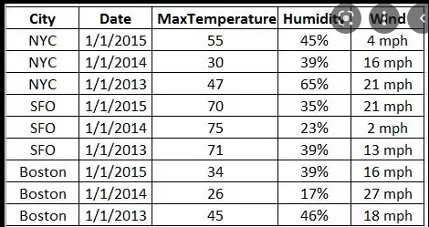
Versus Cross-sectional data
Cross-sectional data, or a cross section of a study population, in statistics and econometrics, is a type of data collected by observing many subjects at the one point or period of time.
The analysis might also have no regard to differences in time

Slide 4
Time Series Data
Time series data is a sequence of observations
  collected from a process
  with equally spaced periods of time.
The major purpose of forecasting with time series is to extrapolate beyond the range of the explanatory variables.

Slide 5
Time Series vs.
Cross Sectional Data
Time series is dynamic, it does change over time.
Cross-sectional data, or a cross section of a study population, in statistics and econometrics, is a type of data collected by observing many subjects at the one point or period of time. The analysis might also have no regard to differences in time

Slide 6
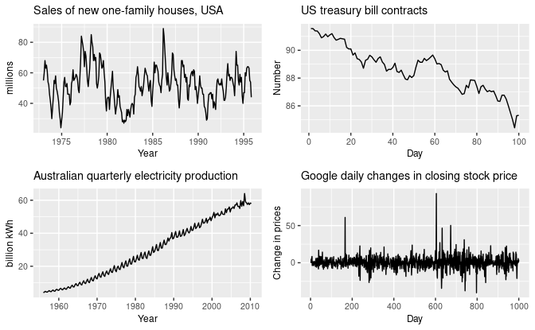
Patterns

Slide 7
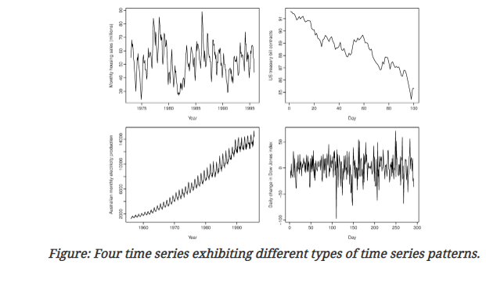
Patterns
The monthly housing sales (top left) show strong seasonality within each year, as well as some strong cyclic behaviour with period about 6–10 years. There is no apparent trend in the data over this period.
The US treasury bill contracts (top right) show results from the Chicago market for 100 consecutive trading days in 1981. Here there is no seasonality, but an obvious downward trend. Possibly, if we had a much longer series, we would see that this downward trend is actually part of a long cycle, but when viewed over only 100 days it appears to be a trend.
The Australian monthly electricity production (bottom left) shows a strong increasing trend, with strong seasonality. There is no evidence of any cyclic behaviour here.
The daily change in the Dow Jones index (bottom right) has no trend, seasonality or cyclic behaviour. There are random fluctuations which do not appear to be very predictable, and no strong patterns that would help with developing a forecasting model.

Slide 8
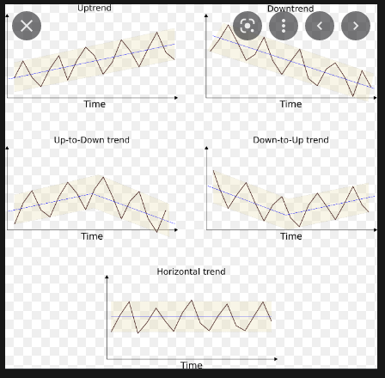
Trends

Slide 9
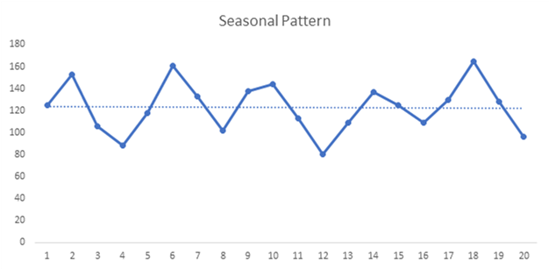
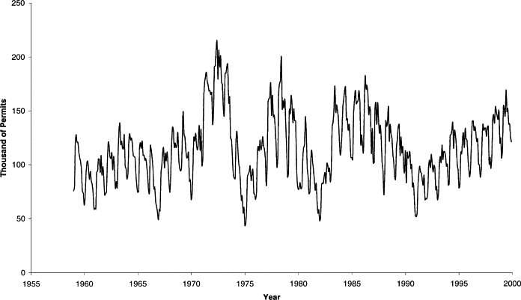
Seasonal Pattern

Slide 10
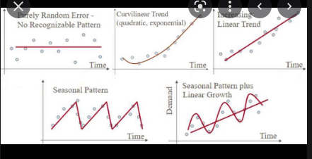
Patterns

Slide 11
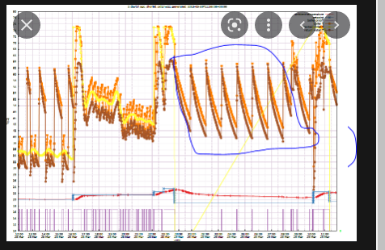
Patterns

Slide 12
Time Series Components
Notes:
17

Slide 13
Time Series Components
Trend
Notes:
18

Slide 14
Time Series Components
Trend
Cyclical
Notes:
19

Slide 15
Time Series Components
Trend
Cyclical
Seasonal
Notes:
20

Slide 16
Time Series Components
Trend
Cyclical
Seasonal
Irregular
Notes:
21

Slide 17
Trend Component
Overall Upward or Downward Movement
Data Taken Over a Period of Years
Sales
Upward trend
Time

Slide 18
Cyclical Component
Repeating up & down movements
Due to interactions of factors (say influencing economy)
Usually 2-10 years duration
Cycle
Response
Mo., Qtr., Yr.
Notes:
23

Slide 19
Cyclical Component
Upward or Downward Swings
May Vary in Length
Usually Lasts 2 - 10 Years
Sales
Cycle
Time

Slide 20
Seasonal Component
Regular pattern of up & down fluctuations
Due to weather, customs etc.
Occurs within one year
Summer
Response
© 1984-1994 T/Maker Co.
Mo., Qtr.
Notes:
24

Slide 21
Seasonal Component
Upward or Downward Swings
Regular Patterns
Observed Within One Year
Winter
Sales
Time (Monthly or Quarterly)

Slide 22
Irregular Component
Erratic, unsystematic, ‘residual’ fluctuations
Due to random variation or unforeseen events
  Union strike
  War
Short duration &
nonrepeating
© 1984-1994 T/Maker Co.
Notes:
25

Slide 23
Random or Irregular Component
Erratic, Nonsystematic, Random, ‘Residual’ Fluctuations
Due to Random Variations of
  Nature
  Accidents
Short Duration and Non-repeating

Slide 24
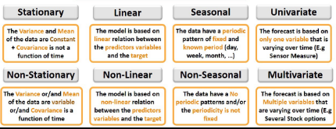
Time Series

Slide 25
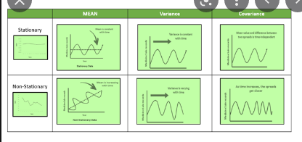
Stationary: A dataset should follow the below thumb rules, without having Trend, Seasonality, Cyclical, and Irregularity component of time series
The MEAN value of them should be completely constant in the data during the analysis
The VARIANCE should be constant with respect to the time-frame
The COVARIANCE measures the relationship between two variables.

Slide 26
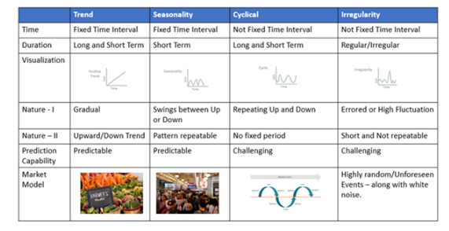
Time Series

Slide 27
Thank You

